Slide 1

Unsupervised Learning Algorithms
Agenda
Introduction to Recommender Systems
Understanding PCA Mechanism
Limitations of PCA
Applications

Slide 2
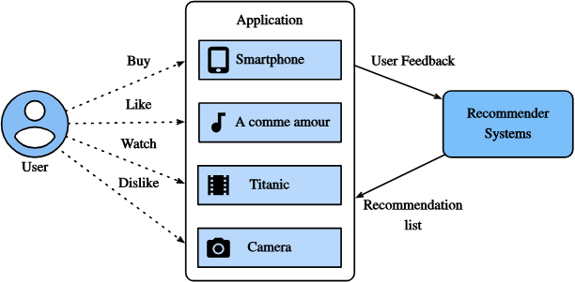
What is a Recommender System?
Definition: A system that suggests relevant items to users based on past interactions.
Examples: Netflix → Recommends movies 🎬 ,Amazon → Suggests products 🛍️,
Spotify → Creates personalized playlists 🎵 , Purpose: Helps users find relevant content quickly.

Slide 3
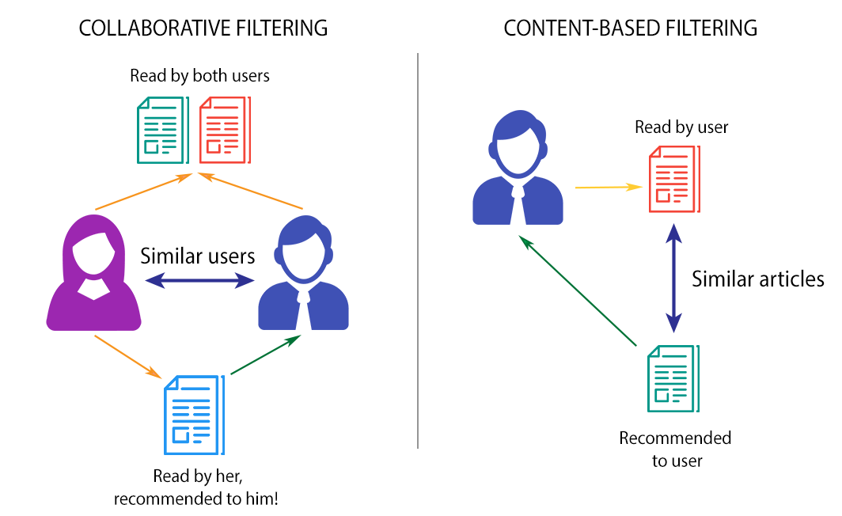
Types of Recommendation Approaches

Slide 4
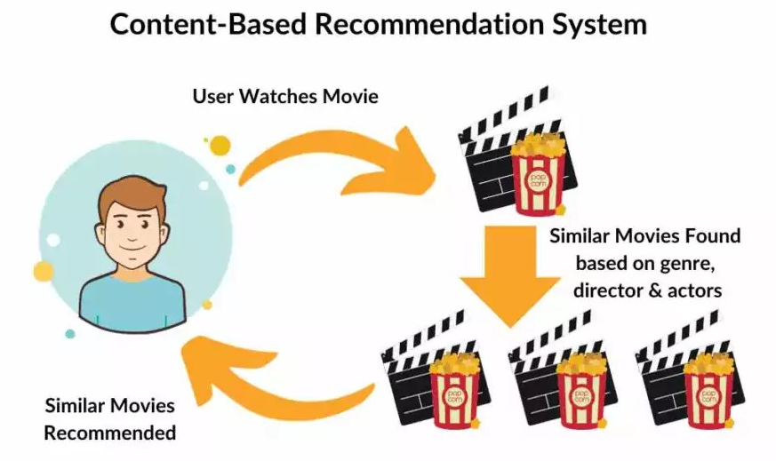
Content-Based Filtering
Definition: A recommendation approach that suggests items similar to those a user has already liked.
Works Like: "If you liked this, you might like that!"
Example:
A user who watches sci-fi movies will get recommendations for more sci-fi movies.
A reader who enjoys mystery novels will see more books from the same genre.

Slide 5
How Does Content-Based Filtering Work?
1️⃣ Extract Features from Items
Example: A movie has genre, director, actors, language, duration as features. 2️⃣ Create a User Profile
Store preferences based on the user’s past interactions. 3️⃣ Calculate Similarity Between Items
Uses Cosine Similarity, TF-IDF, or Euclidean Distance to measure similarity. 4️⃣ Recommend Similar Items
Suggests new content based on the user’s past choices.

Slide 6
Example of Content-Based Filtering
📚 Book Recommendation Example:
Book | Genre | Author
Book A | Sci-Fi | Author X
Book B | Sci-Fi | Author Y
Book C | Mystery | Author Z
If a user likes Book A, the system suggests Book B (same genre: Sci-Fi).

Slide 7
Advantages & Disadvantages of Content-Based Filtering
✅ Advantages:
Personalized recommendations tailored to the user.
No need for large amounts of user data.
❌ Disadvantages:
Cold Start Problem → New users/items have no historical data.
Limited Diversity → Only suggests similar content, doesn’t explore new categories.

Slide 8
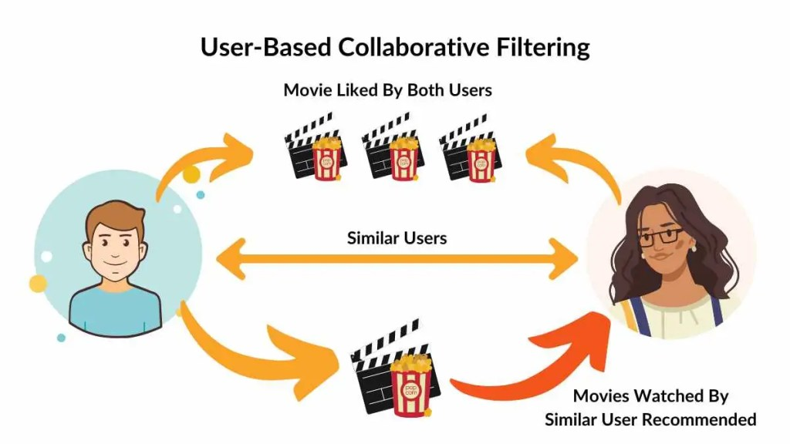
Collaborative Filtering
Definition: A recommendation approach that suggests items based on user behavior and preferences.
Works Like: "Users who liked this also liked that!"
Example:
If User A and User B have similar interests, the system recommends items liked by User B to User A, and vice versa.

Slide 9
How Does Collaborative Filtering Work?
1️⃣ Collect User-Item Interaction Data
Example: Ratings, purchases, views, likes, etc.
2️⃣ Find Similar Users or Items
Uses Cosine Similarity, Pearson Correlation, or Jaccard Similarity.
3️⃣ Predict Ratings or Preferences
Based on what similar users/items interacted with.
4️⃣ Recommend Items
Suggests the most relevant products, movies, books, etc.

Slide 10
Example of Collaborative Filtering
🎥 Movie Recommendation Example:
User | Movie A (Sci-Fi) | Movie B (Action) | Movie C (Sci-Fi) | Movie D (Drama)
Alice | 5⭐ | 2⭐ | ? | 3⭐
Bob | 4⭐ | 3⭐ | 5⭐ | 2⭐
Alice has not watched Movie C, but Bob (who has similar tastes) gave it 5⭐.
The system predicts Alice will like Movie C and recommends it.

Slide 11
Advantages & Disadvantages of Collaborative Filtering
✅ Advantages:
No need for item-specific features.
Learns automatically from user interactions.
❌ Disadvantages:
Cold Start Problem → Struggles with new users/items.
Scalability Issue → Requires large amounts of data.

Slide 12
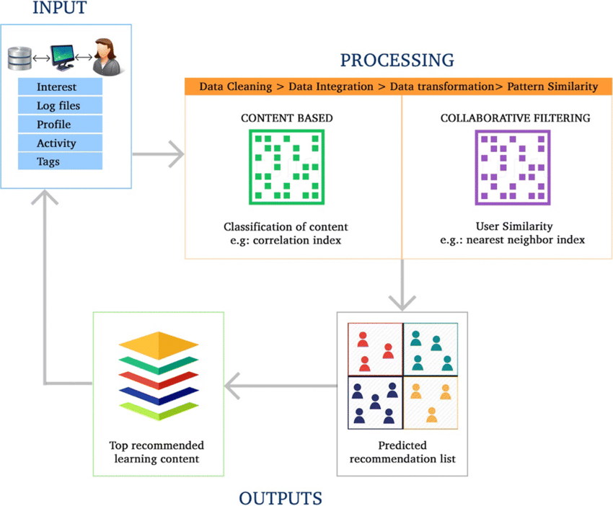
Hybrid Recommender Systems
Definition: A recommendation approach that combines multiple filtering techniques (Collaborative + Content-Based).
Why Hybrid?
Overcomes limitations of Collaborative Filtering (Cold Start Problem).
Improves accuracy by integrating Content-Based Filtering.
Works better for diverse datasets.

Slide 13
How Does Hybrid Filtering Work?
There are multiple ways to combine Collaborative and Content-Based filtering:
1️⃣ Weighted Hybrid Model
Assigns different weights to Collaborative and Content-Based recommendations.
Example:
70% from Collaborative Filtering
30% from Content-Based Filtering
2️⃣ Switching Hybrid Model
Uses Collaborative Filtering for old users and Content-Based Filtering for new users.
Solves the Cold Start Problem.
3️⃣ Cascade Hybrid Model
First applies Content-Based Filtering, then Collaborative Filtering refines results.
4️⃣ Feature Combination Hybrid Model
Merges features from both models into a single recommendation system.

Slide 14
Example of Hybrid Recommendation
🎥 Movie Recommendation Example:
User | Likes Sci-Fi? | Likes Action? | Likes Drama? | Watched "Interstellar"?
Alice | ✅ | ❌ | ✅ | ❌
Bob | ✅ | ✅ | ❌ | ✅
Step 1: Content-Based Filtering
Alice likes Sci-Fi & Drama → Recommends Sci-Fi movies.
Step 2: Collaborative Filtering
Bob (similar to Alice) watched "Interstellar".
The system recommends "Interstellar" to Alice.
💡 Final Recommendation: "Interstellar" (from both techniques).

Slide 15
Advantages & Disadvantages of Hybrid Filtering
✅ Advantages:
More accurate recommendations.
Solves Cold Start Problem for new users/items.
Balances personalization and popularity.
❌ Disadvantages:
Computationally expensive.
More complex than standalone models.

Slide 16
Real-World Applications of Hybrid Recommendation
💻 Netflix → Uses Hybrid Filtering to recommend movies/shows. 🛒 Amazon → Recommends products based on both user behavior and product features. 🎶 Spotify → Suggests songs using a mix of Collaborative & Content-Based Filtering.

Slide 17
Thank You

